Slide 1
STUDENT DASHBOARD
NEW ASSIGNMENTS
COMPUTER SCIENCE TEST
Java OOP ● Teacher name
Due date:
01/01/2020 12:00 pm
HISTORY EXAM
US ● Teacher name
Due date:
01/01/2020 12:00 pm

Slide 2
STUDENT DASHBOARD
COMPLETED ASSIGNMENTS
COMPUTER SCIENCE TEST
Java OOP ● Teacher name
Completion date:
01/01/2020 12:00 pm
HISTORY EXAM
US ● Teacher name
Due date:
01/01/2020 12:00 pm

Slide 3
STUDENT DASHBOARD
GRADED ASSIGNMENTS
COMPUTER SCIENCE TEST
Java OOP ● Teacher name
Grade:
90
HISTORY EXAM
US ● Teacher name
Grade:
85

Slide 4
TEACHER DASHBOARD
Completed ASSIGNMENTS
COMPUTER SCIENCE TEST
Java OOP ● Student name
Completion date:
01/01/2020 12:00 pm
HISTORY EXAM
US ● Student name
Completion date:
01/01/2020 12:00 pm

Slide 5
TEACHER DASHBOARD
GRADED ASSIGNMENTS
COMPUTER SCIENCE TEST
Java OOP ● Student name
Grade:
90
HISTORY EXAM
US ● Student name
Grade:
85

Slide 6
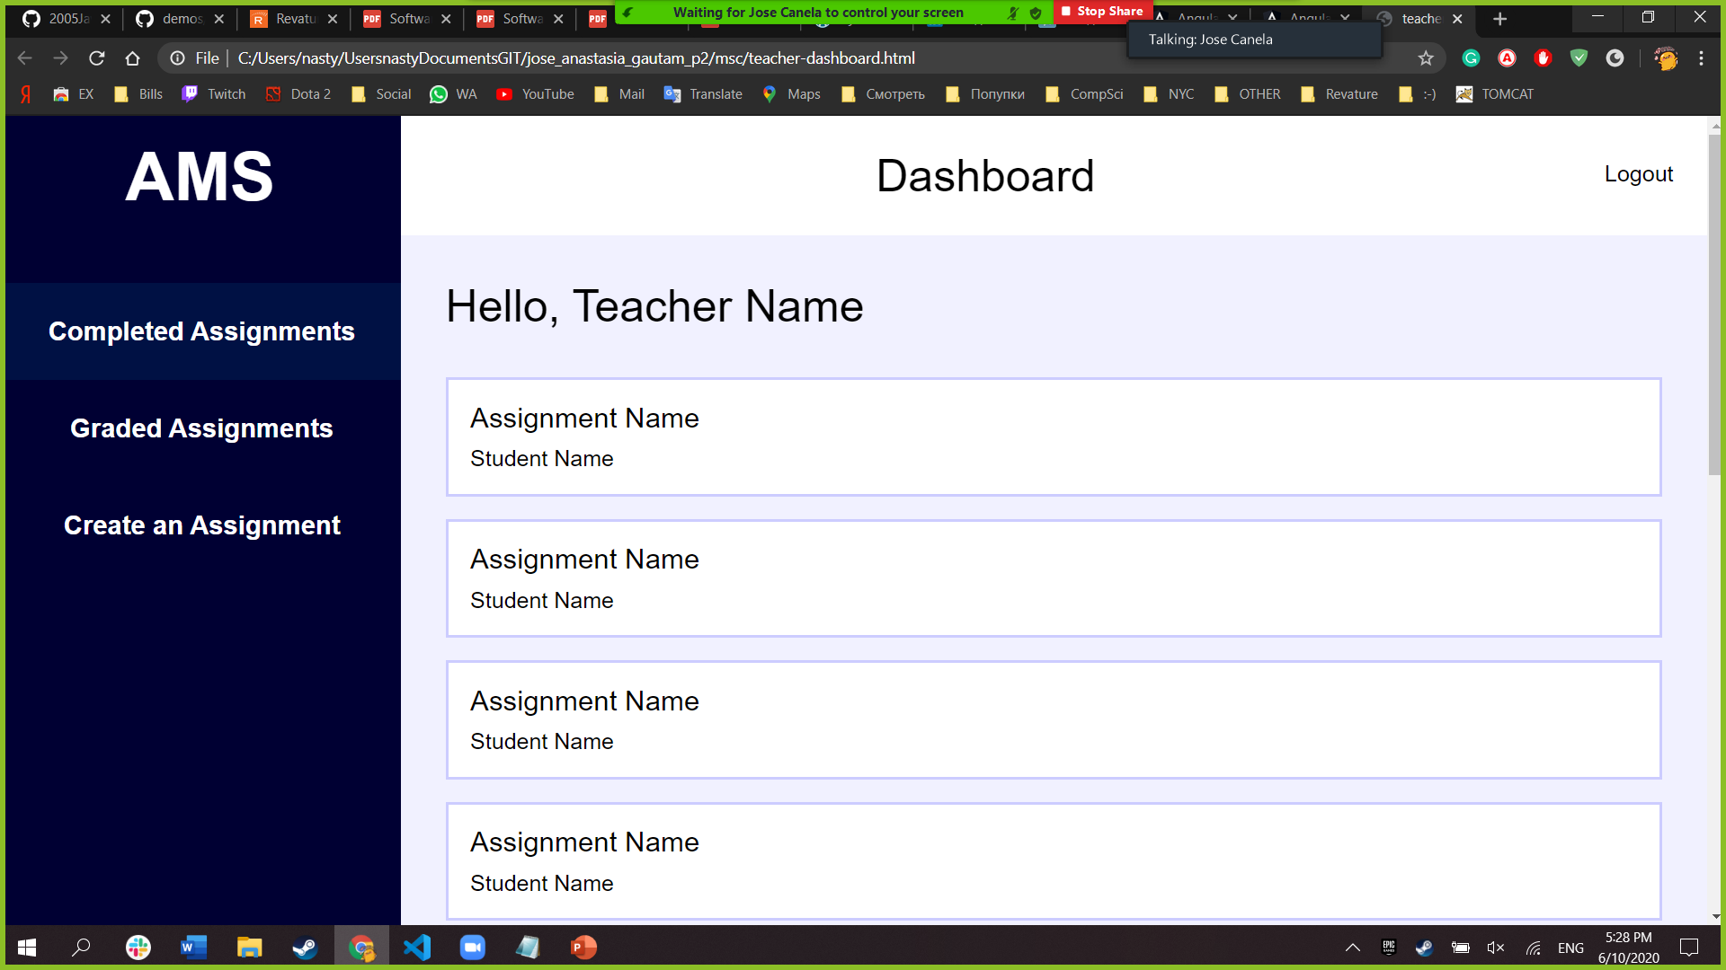
Create an Assignment
Select type of an Assignment:
●
Exam
Homework
Test

Slide 7
Create an Assignment
Title of an Assignment:
Question:
Add question

Slide 8

S C H O O L

Slide 9
Page Components
- TeacherDashboard
- Sidebar, Header, Content
- StudentDashboard
- Sidebar, Header, Content
- TeacherGradedDashboard
- Sidebar, Header, Content
- StudentGradedDashboard
- Sidebar, Header, Content
Content (Student Name/Teacher Name, Assignment[])
Assignment[] -> Subject, Type, Teacher Name, Student Name, Due Date, Completion Date, Grade, Status
Sidebar (Student Sidebar Link Options/Teacher Sidebar Links Options)

Slide 10
Jane Doe (23456)
John Doe
Jane Doe (12345)
Class
1 – 101
2 – 201

Slide 11
Add Students to Class
Search: dsjkak

Slide 12
Create Assignment Content
Type
Homework Exam Project
Title
Assign to (Drop down choose class)
Add question (text box, points text box)
Submit button

Slide 13
Student. Take a new Assignment
TITLE
Question for student
10
Answer of student
SUBMIT

Slide 14
Student. View a Completed Assignment
TITLE
Question for student
10
Answer of student
SUBMIT

Slide 15
Teacher. Grade a Completed Assignment
/
Question for student
10
10
Answer of student
Comment
SUBMIT

Slide 16
Teacher and Student. Graded Assignment
/
Question for student
10
10
Answer of student
Comment
??? Final Grade
Go back

Slide 17
1. student - view - completed
2. student & teacher - view - graded
3. teacher - grade - completed

